Slide 1



SENAI NOTES
Grupo 04
Stack Group
Participantes:
https://github.com/marcobutrico/SENAI-Notes-Stack-Group

Slide 2

O que é o SENAI Notes?

Slide 3










Development Architecture
Frontend
Backend
Database

Slide 4
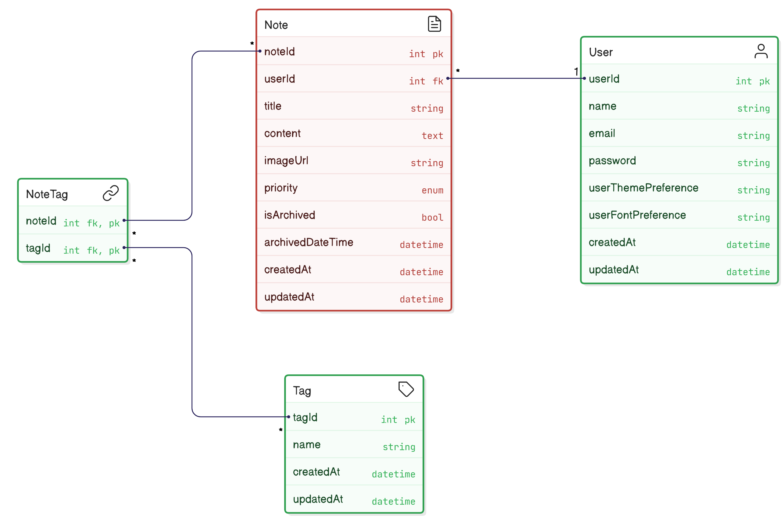
DER

Slide 5
PlantUML
entity User {
*UserId : int <<PK>>
--
name : string // CapitalCase e Unique
email : string // //CapitalCase e Unique
password : string // // letras maiúsculas, minúsculas, números e
caracteres especiais
userThemePreference : int // 1 = System, 2 = Light, 3 = Dark
userFontPreference : int // 1 = Sans-serif, 2 = Serif, 3 = Monospace
createdAt : datetime // now() - Data da criação
updatedAt : datetime // Data da edição
entity Note {
*NoteId : int <<PK>>
--
userId : int <<FK>>
title : string
content : text
imageUrl : string //opcional
priority : int // 1 = High, 2 = Medium, 3 = Low
isArchived : bool
createdAt : datetime // now() - Data da criação
updatedAt : datetime // Data da edição
entity Tag {
*TagId : int <<PK>>
--
name : string // CapitalCase e Unique
createdAt : datetime // now() - Data da criação
updatedAt : datetime // Data da edição
}
entity NoteTag {
*noteId : int <<FK>> <<PK>>
*tagId : int <<FK>> <<PK>>
--
// No duplicate noteId + tagId allowed
}}

Slide 6

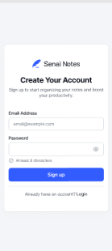
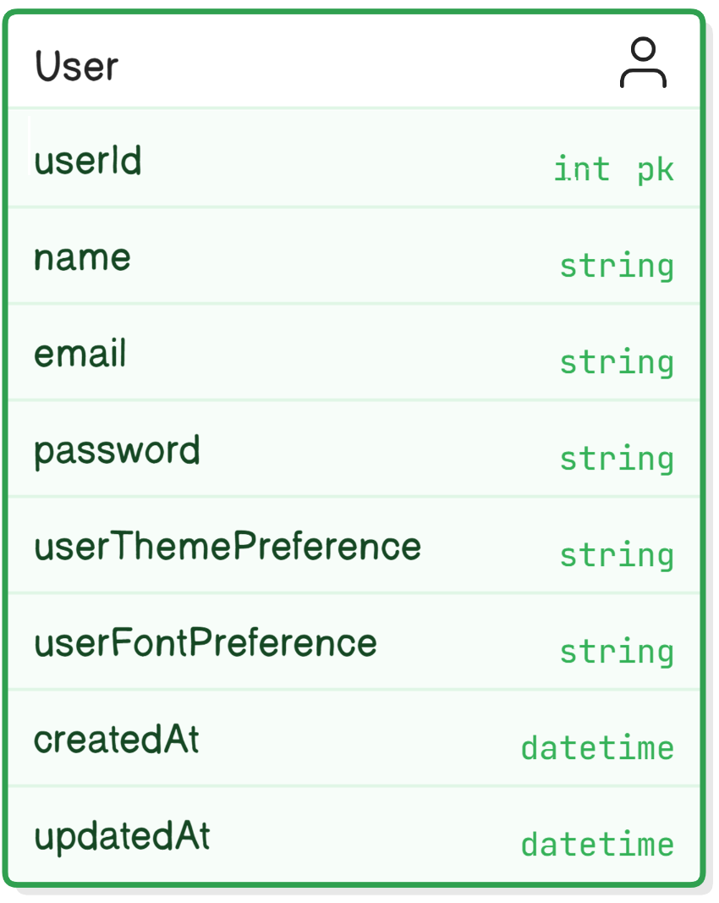
SignUp
Frontend
Backend + Database
➔ <accesspoint>/createUser
JWT hashing
bcrypting

Slide 7
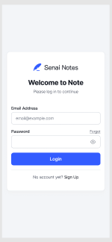
Login
Frontend
Backend + Database
➔ <accesspoint>/login/[email]/[senha]
JWT hashing
bcrypting

Slide 8
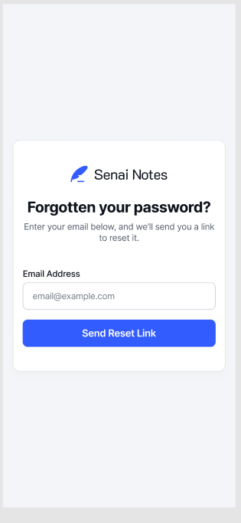
Forgotten Password
Frontend
Backend + Database
➔ <accesspoint>/forgottenpwd/[email]
check if email exists
JWT hashing
bcrypting

Slide 9
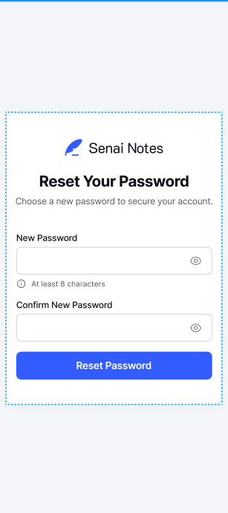
Reset Password
Frontend
Backend + Database
➔ <accesspoint>/resetpwd/[email]
check if email exists
JWT hashing
bcrypting

Slide 10

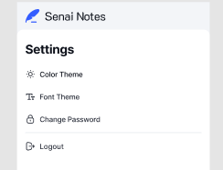
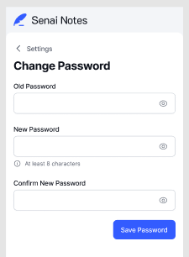
Settings: Change Password
Frontend
Backend + Database
<accesspoint>/changepwd/[email]/
oldpwd/newpd
check if email exists
check if old password is correct
JWT hashing
bcrypting

Slide 11

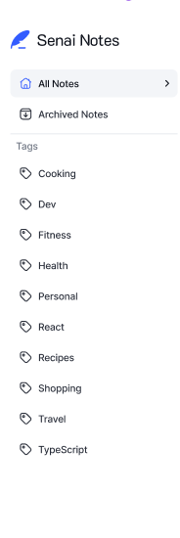
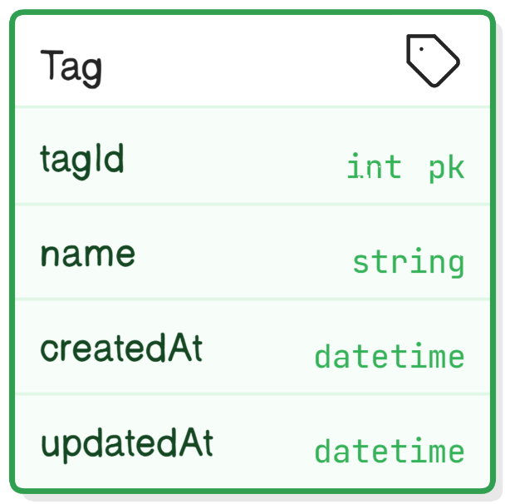
All Notes – Sidebar - Navigation
Frontend
Backend + Database
➔ <accesspoint>/getAllTagsAsync
using asynchronous event

Slide 12
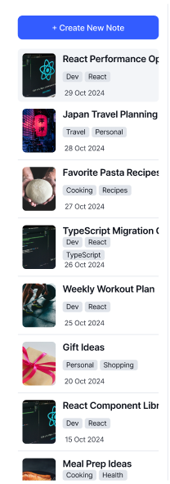
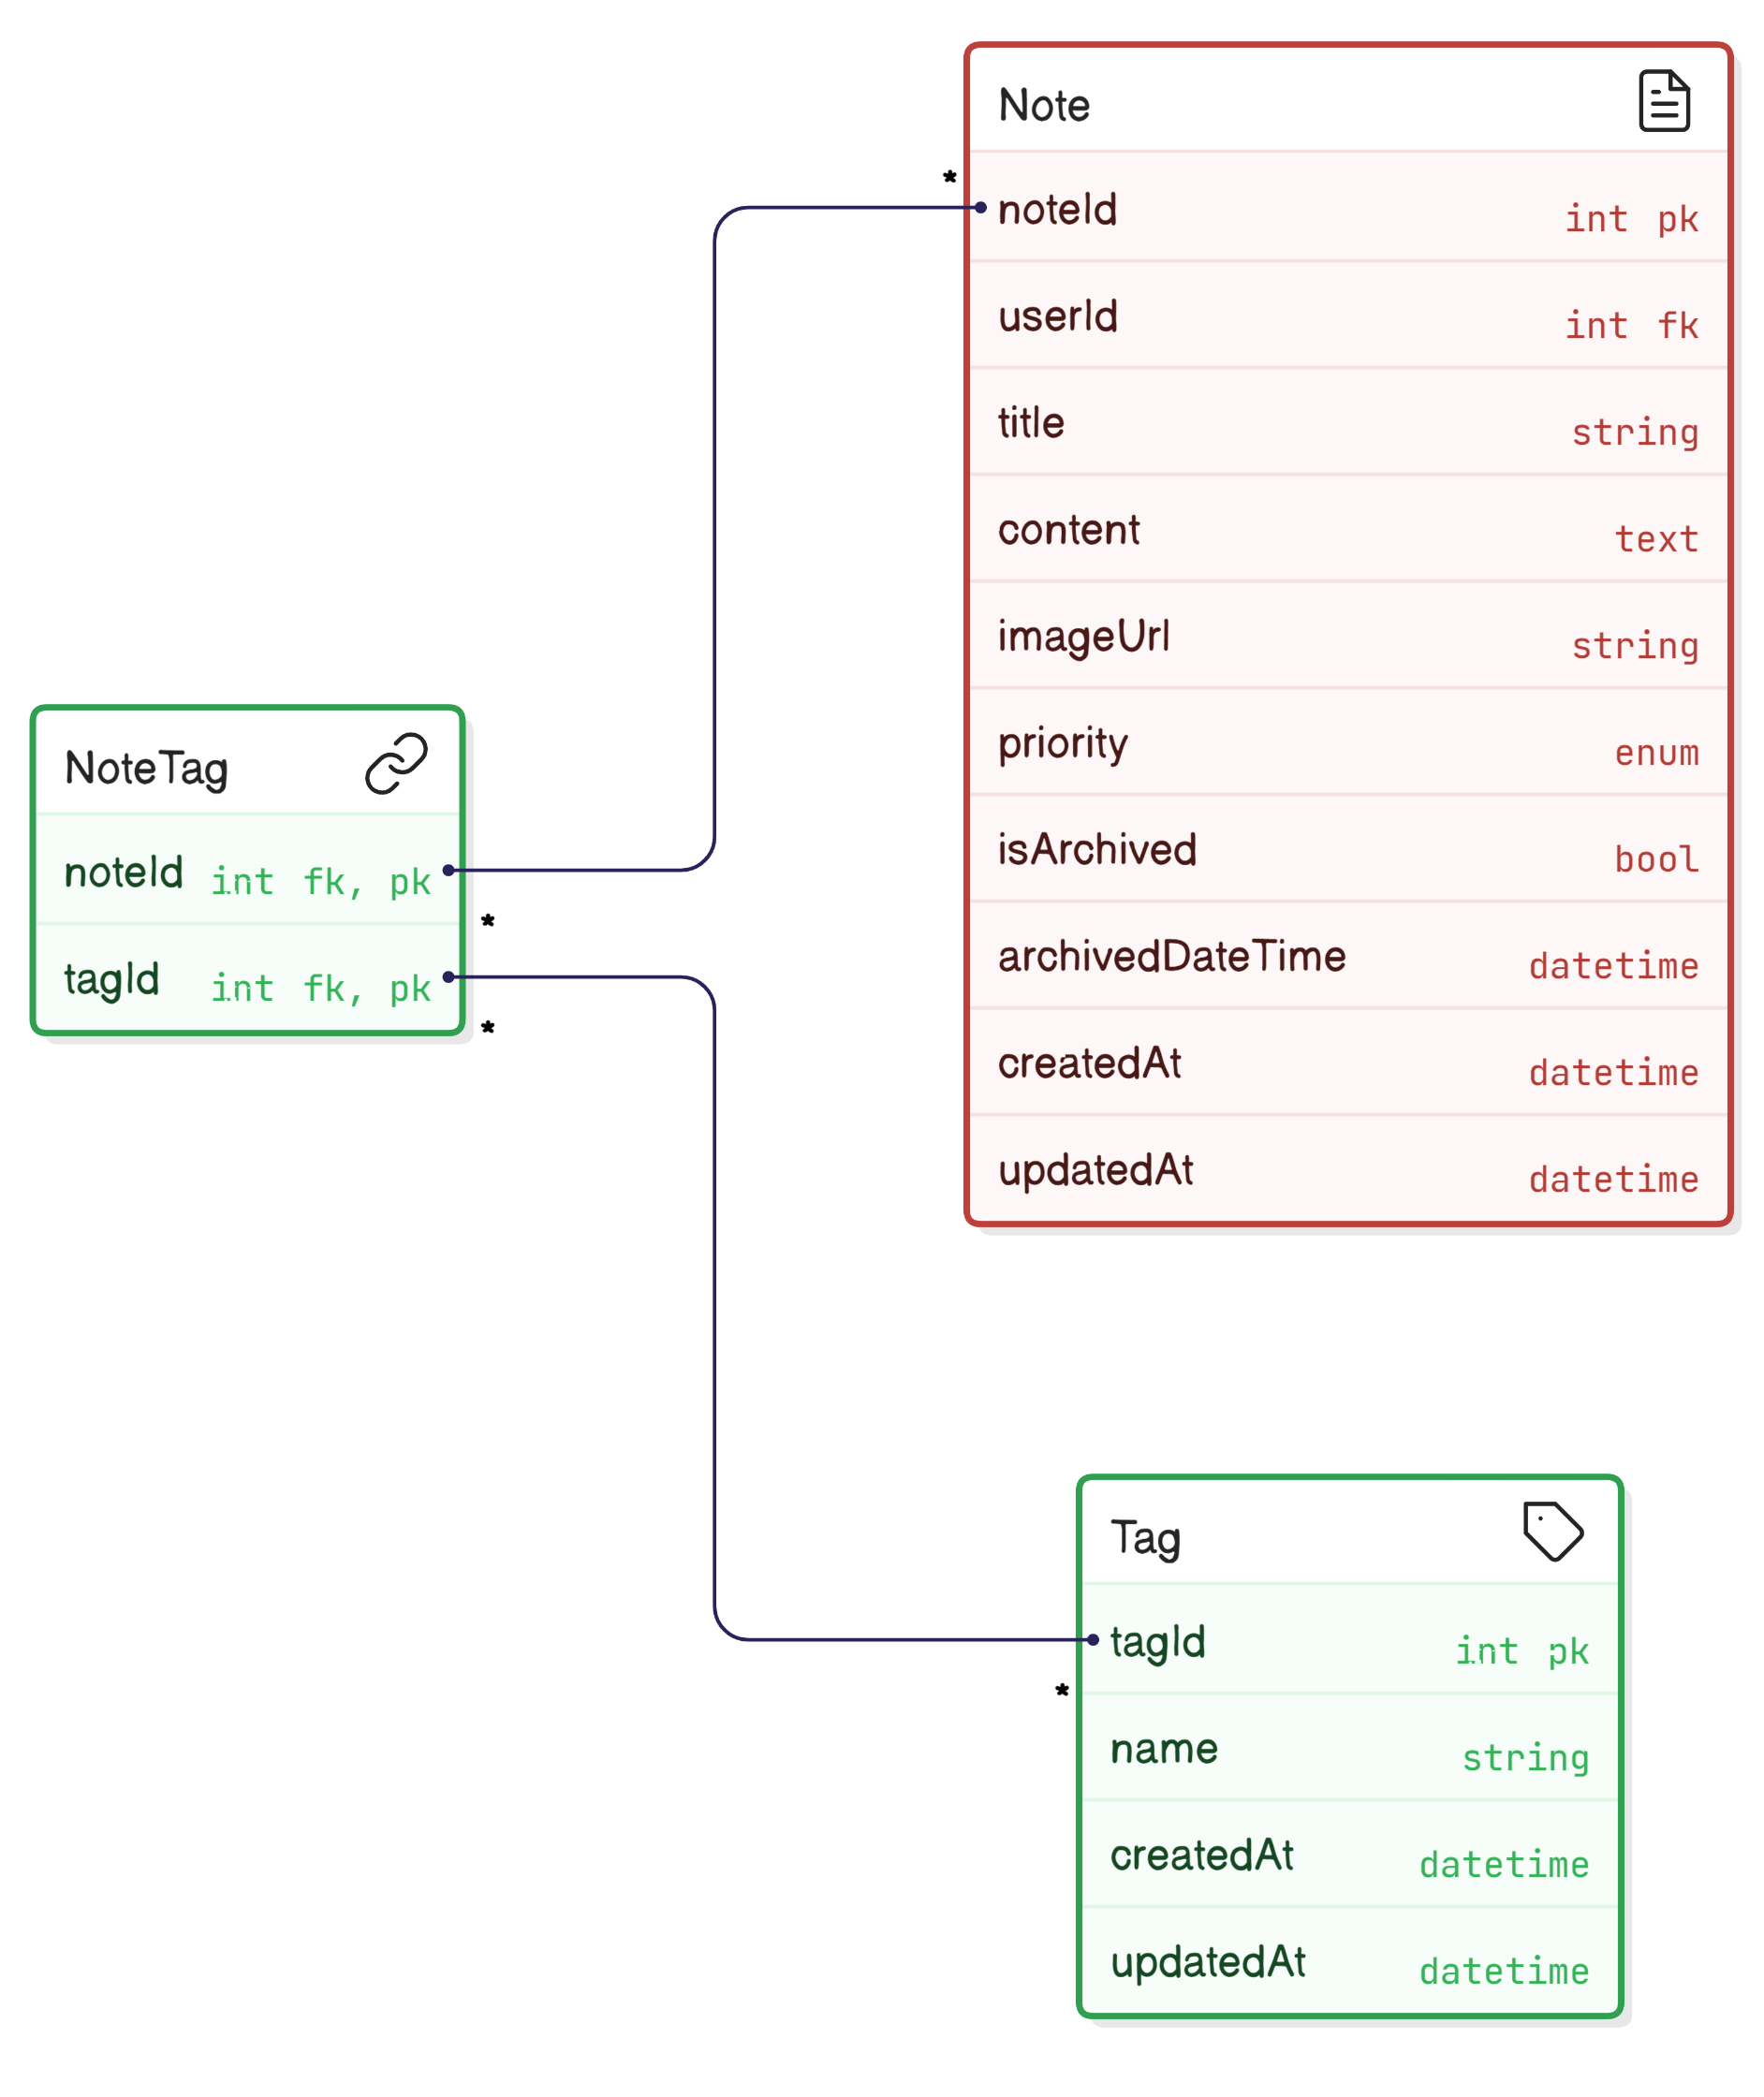
All Notes – Sidebar – All Notes
Frontend
Backend + Database
➔ <accesspoint>/getAllNotesAsync
inner join NoteTag, Tag, Note using asynchronous event

Slide 13
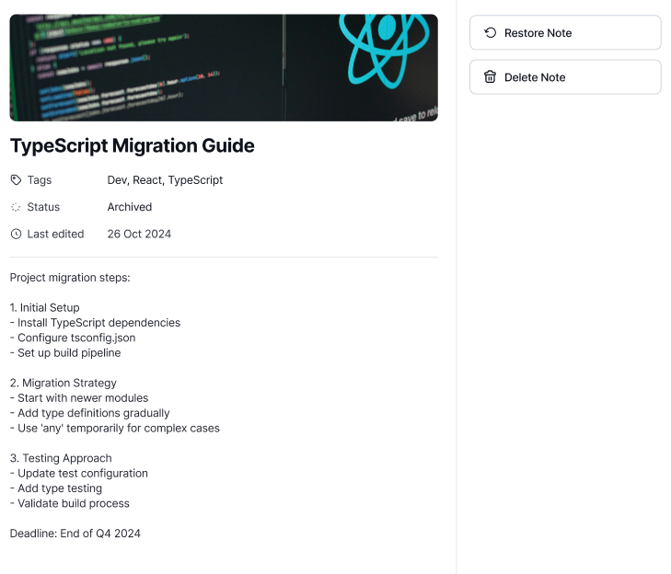
Note – Show note
Frontend
Backend + Database
➔ <accesspoint>/getNoteAsync/[id]
inner join NoteTag, Tag, Note using asynchronous event

Slide 14
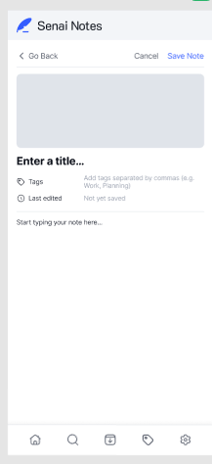
Create New Note / Create Tag
Frontend
Backend + Database
➔ <accesspoint>/createNoteAsync
➔ <accesspoint>/createTagAsync
using asynchronous event

Slide 15
Edit Note
Frontend
Backend + Database
➔ <accesspoint>/updateNoteAsync
using asynchronous event

Slide 16
Delete Note
Frontend
Backend + Database
➔ <accesspoint>/deleteNote/[id]

Slide 17
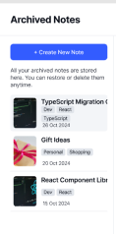
Archived Notes
Frontend
Backend + Database
Get archived notes
➔ <accesspoint>/getAllarchiveNotesSync
using asynchronous event
Set note to be archived
➔ <accesspoint>/archiveNote/[id]
Restore note from archived
➔ <accesspoint>/unarchiveNote/[id]

Slide 18

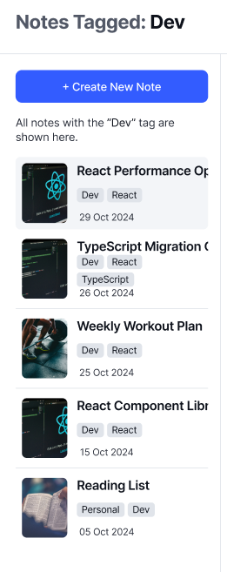
Tag Selected
Frontend
Backend + Database
Get all notes from selected tag
➔ <accesspoint>/getAllNotesfromTagAsync/[id]
using asynchronous event

Slide 19
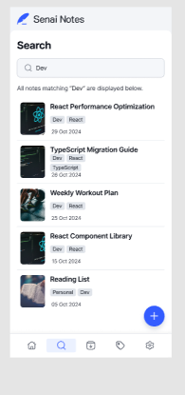
Search
Frontend
Backend + Database
➔ <accesspoint>/searchNoteAsync/[keyword]
using asynchronous event
browse among the Fields: title, tags, contents

Slide 20
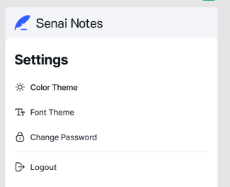
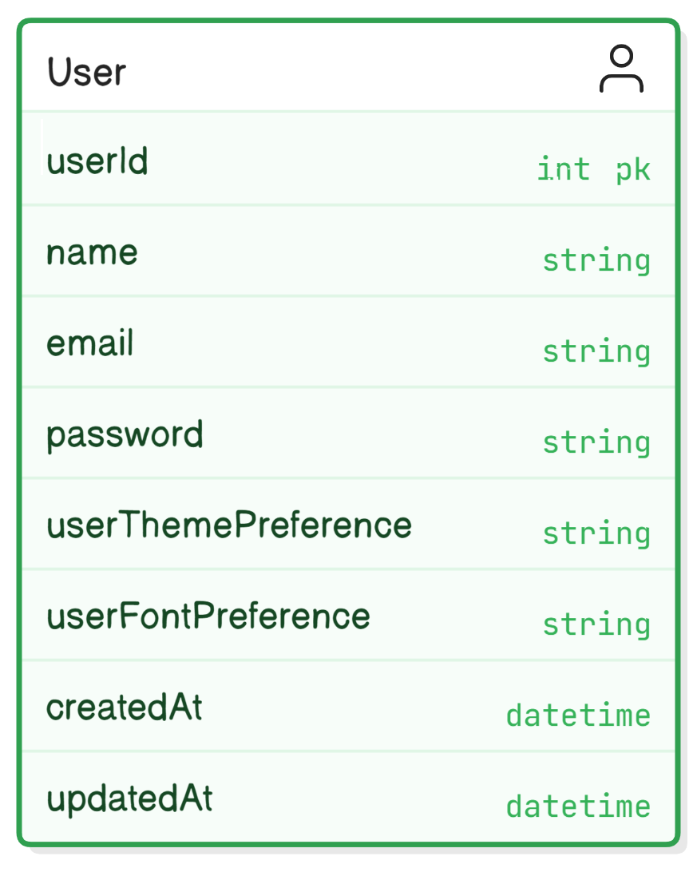
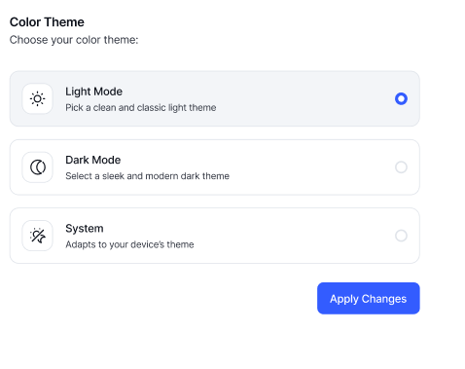
Settings – User Theme
Frontend
Backend + Database
➔ <accesspoint>/getUserTheme/[choice]
➔ <accesspoint>/setUserTheme/[choice]

Slide 21
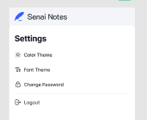
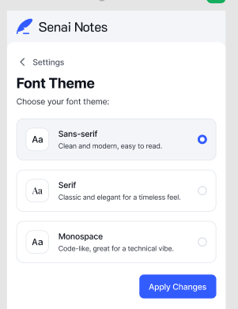
Settings – User Font
Frontend
Backend + Database
➔ <accesspoint>/getUserFont/[choice]
➔ <accesspoint>/setUserFont/[choice]

Slide 22

List of endpoints
➔ <accesspoint>/updateNoteAsync
➔ <accesspoint>/createUser
➔ <accesspoint>/deleteNote/[id]
➔ <accesspoint>/login/[email]/[senha]
➔ <accesspoint>/getAllarchiveNotesSync
➔ <accesspoint>/forgottenpwd/[email]
➔ <accesspoint>/archiveNote/[id]
➔ <accesspoint>/resetpwd/[email]
➔ <accesspoint>/unarchiveNote/[id]
<accesspoint>/changepwd/[email]/ oldpwd/newpd
➔ <accesspoint>/getAllNotesfromTagAsync/[id]
➔ <accesspoint>/getAllTagsAsync
➔ <accesspoint>/searchNoteAsync/[keyword]
➔ <accesspoint>/getAllNotesAsync
➔ <accesspoint>/getUserTheme/[choice]
➔ <accesspoint>/getNoteAsync/[id]
➔ <accesspoint>/setUserTheme/[choice]
➔ <accesspoint>/createNoteAsync
➔ <accesspoint>/getUserFont/[choice]
➔ <accesspoint>/createTagAsync
➔ <accesspoint>/setUserFont/[choice]
21 endpoints

Slide 23

Reports

